Slide 1
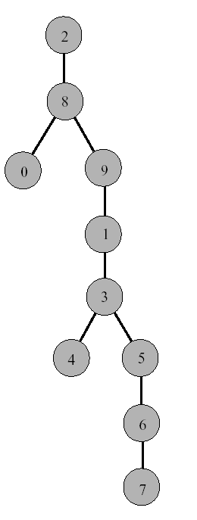
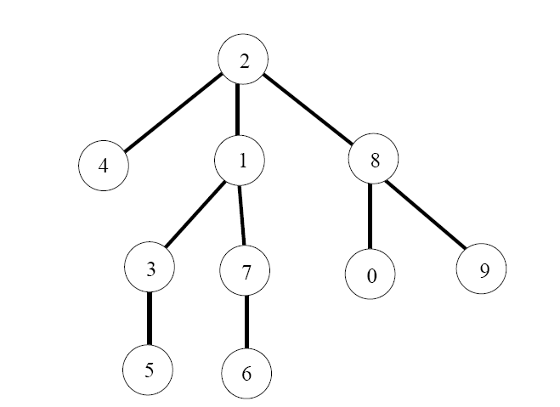
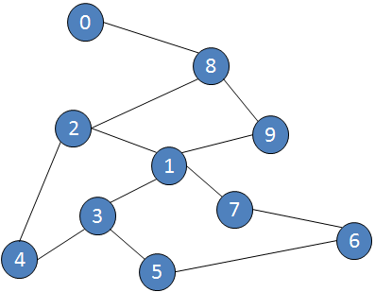
Spanning tree unweighted Graph
Through Breadth-First-Search & Depth-First-Search

Slide 2
What is Spanning Tree
a subset of a graph G, which all the vertices of G same connected all vertices, different edges
does not contain cycles
all connected and undirected graph G has at least one spanning tree
Minimum Spanning Tree
covers all vertices with possible number of edges or weight

Slide 3
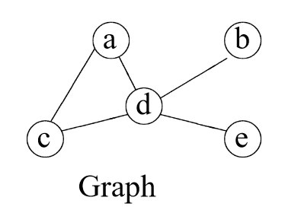
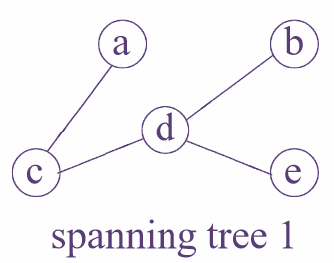
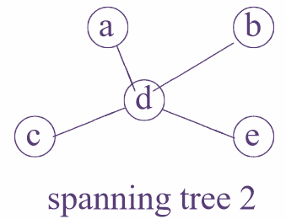
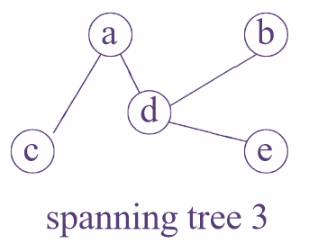
Spanning tree unweighted Graph

Slide 4
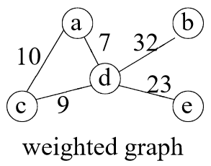
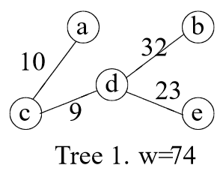
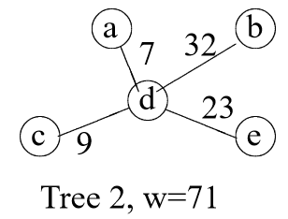
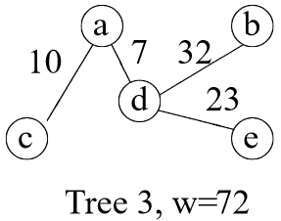
Spanning tree weighted Graph

Slide 5
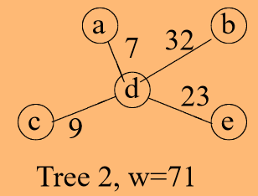
Spanning tree weighted Graph

Slide 6
Finding minimum spanning tree
Kruskal’s algorithm
PRIM’s algorithm

Slide 7
Kruskal’s algorithm
1. Start with an edge with the smallest edge
2. Select the next smallest weight edge
3. Continue to include other edges just until all vertices covered.
4. Calculate the total weight (cost)

Slide 8
Kruskal’s algorithm
T={}

Slide 9
Kruskal’s algorithm
1. Start with an edge with the smallest edge
T={(a, d)}

Slide 10
Kruskal’s algorithm
2. Select the next smallest weight edge
T={(a, d), (d, c)}

Slide 11
Kruskal’s algorithm
T={(a, d), (d, c)}

Slide 12
Kruskal’s algorithm
3. Continue to include other edges just until all vertices covered.
T={(a, d), (d, c), (d, e)}

Slide 13
Kruskal’s algorithm
T={(a, d), (d, c), (d, e), (d, b)}

Slide 14
Kruskal’s algorithm
4. Calculate the total weight (cost)
T={(a, d), (d, c), (d, e), (d, b)}
=7 + 9 + 23 + 32 = 71

Slide 15
Spanning tree weighted Graph

Slide 16
Prim’s Algorithm
1. Start with an arbitrary vertex
2. Select the next vertex connected by an edge with smallest weight
3. Continue to include other edges just until all vertices covered.
4. Calculate the total weight (cost)

Slide 17
Prim’s algorithm
Visited ={}

Slide 18
Prim’s algorithm
1. Start with an arbitrary vertex
Visited={a}

Slide 19
Prim’s algorithm
2. Select the next vertex connected by an edge with smallest weight
Visited={a, d}

Slide 20
Prim’s algorithm
Visited={a, d, c}

Slide 21
Prim’s algorithm
3. Continue to include other edges just until all vertices covered.
T={a, d, c, e}

Slide 22
Prims’s algorithm
4. Calculate the total weight (cost)
T={a, d, c, e, b}
=7 + 9 + 23 + 32 = 71

Slide 23
End of Slides

